Slide 1


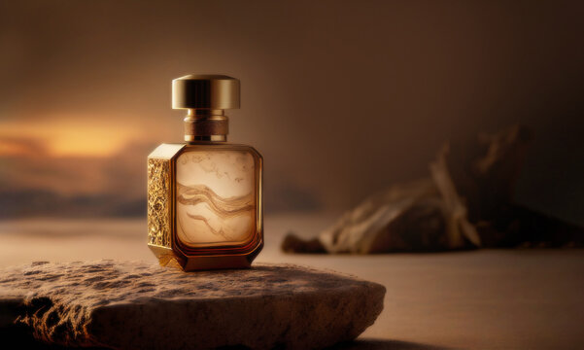

N.B.P COMPANY
01.14.2024
Let’s see
Natural Biological Perfume

Slide 2

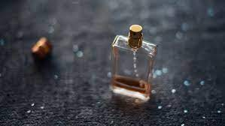

Agenda
1 | About the company
2 | Company Products
3 | Products made by
4 | Future Plan

Slide 3
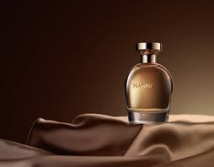


About the Company
The company was founded in 2012 and still produces popular perfumes
In 2021,our company has become the most famous perfume company in the world and earned the trust of its customers
Back to Agenda

Slide 4

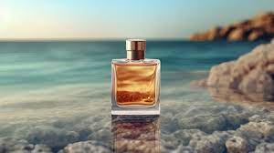
Our Mission and Vision
Mission
Vision
to hold our place in the future
so many pefumes smell so good
Back to Agenda

Slide 5







Our Goals
Goal # 1
Goal # 2
Goal # 3
making the desing unique
to be the first among our competitors
boost advertising
Back to Agenda

Slide 6


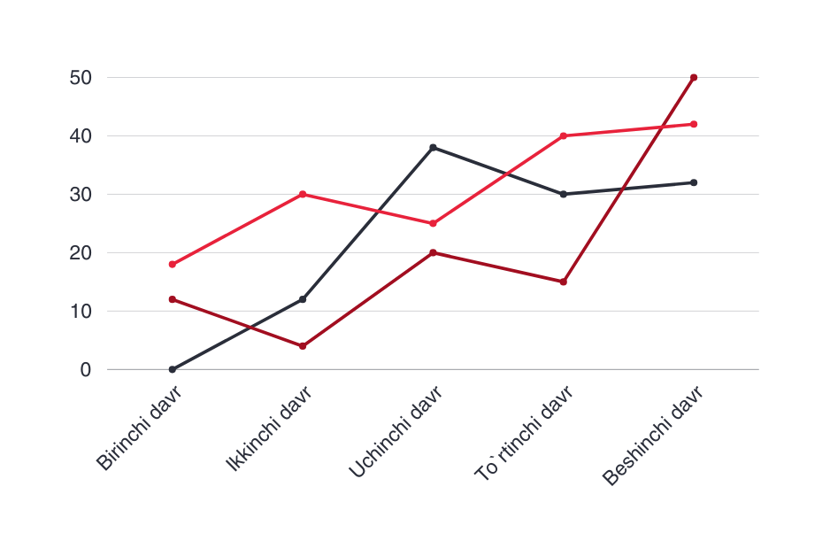
Our Traction
Monthly Revenue:
20 Billion
Average Revenue/Customer:
$300.000
Monthly Revenue Growth:
60%
Back to Agenda

Slide 7





Our Market
10 Billion
5 Billion
Total Available Market (TAM):
10 Billion
1 Billion
Serviceable Available Market (SAM):
5 Billion
Serviceable Obtainable Market (SOM):
1 Billion
Back to Agenda

Slide 8

Our Milestones
2022
2023
2024
2025
We have become one of the famous companies
We caught the competition
We are in the leading position in the world
Perfumes with a new type and unique smell and design
Back to Agenda

Slide 9

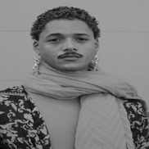
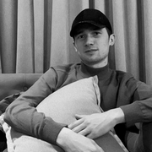


Our Management Team
Eshchanova Gulnora
Chief Executive Officer
Maqsudov Anvar
Chief Finance Officer
Ne`matov Behruz
Our team
Director
Carl Miller
Accountant
Saidova Jasmina
Finance Manager
Back to Agenda

Slide 10
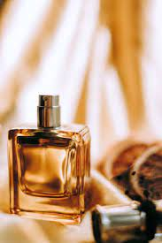

Our Offered Services
Fast delivery services
Quality guarantee for our perfumes
Perfume sorting service
Back to Agenda

Slide 11

Burning wood
Dried hurbs
Our perfume made by
Made by
Maceration
Oil
Water

Slide 12
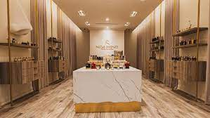
N.B.P COMPANY
Connect with us.
Email
orziyevgabek67@gmail.com
Social Media
@starc055
Call us
+998 93 110 26 81

